Slide 1
What’s new in Hadoop 3?

Slide 2
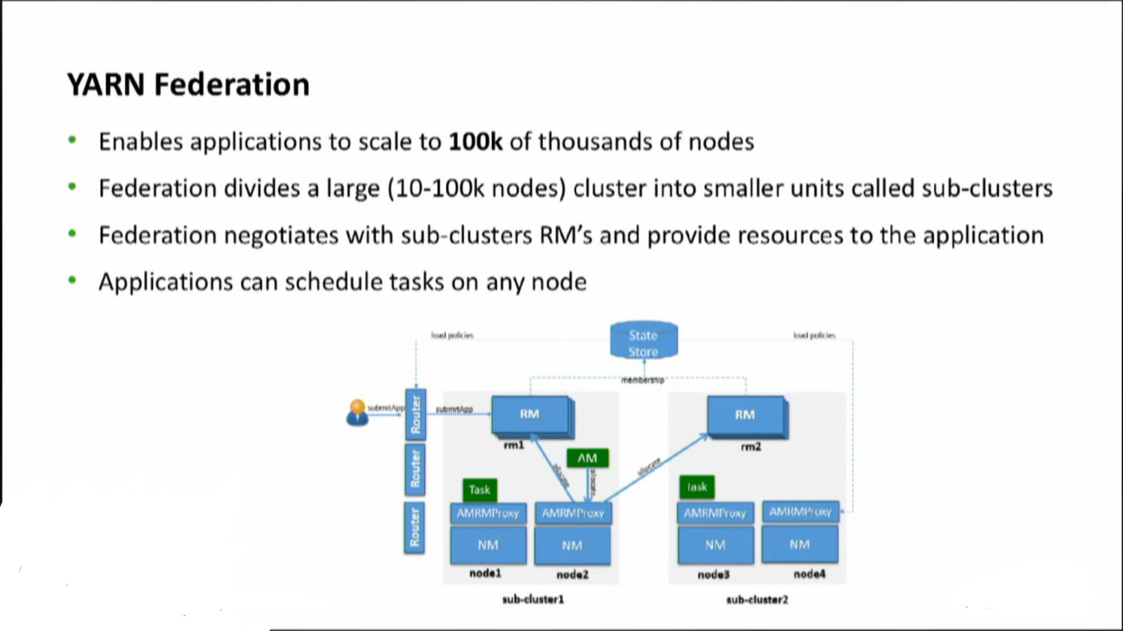
What’s new in Hadoop 3?

Slide 3
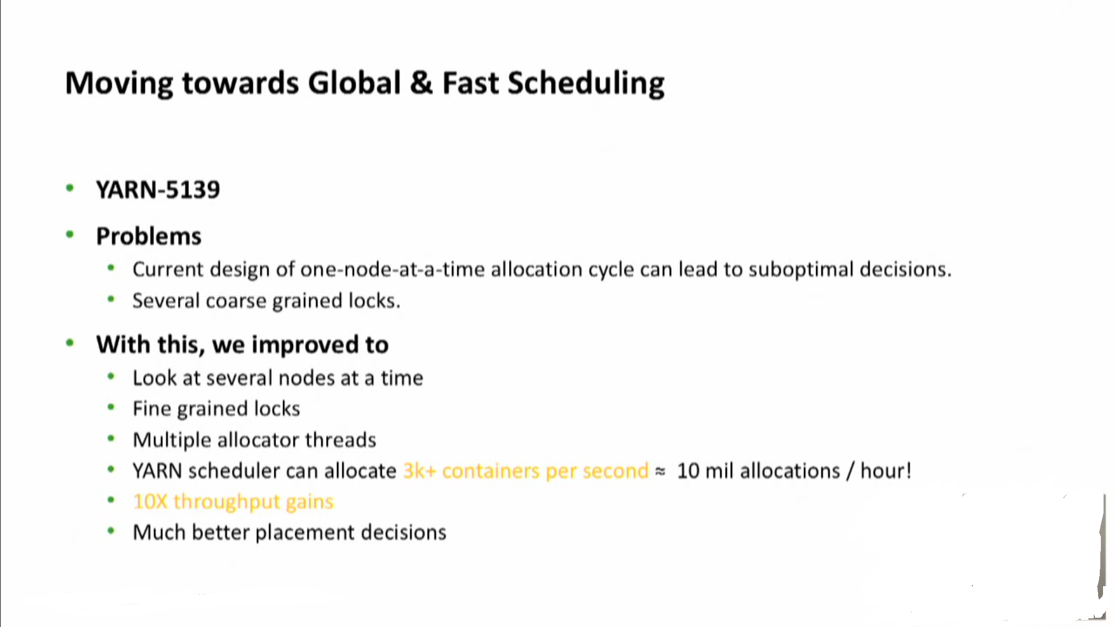
What’s new in Hadoop 3?

Slide 4
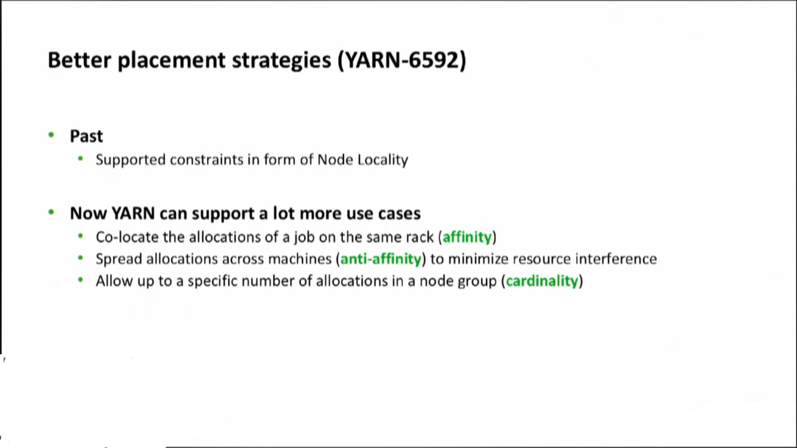
What’s new in Hadoop 3?

Slide 5
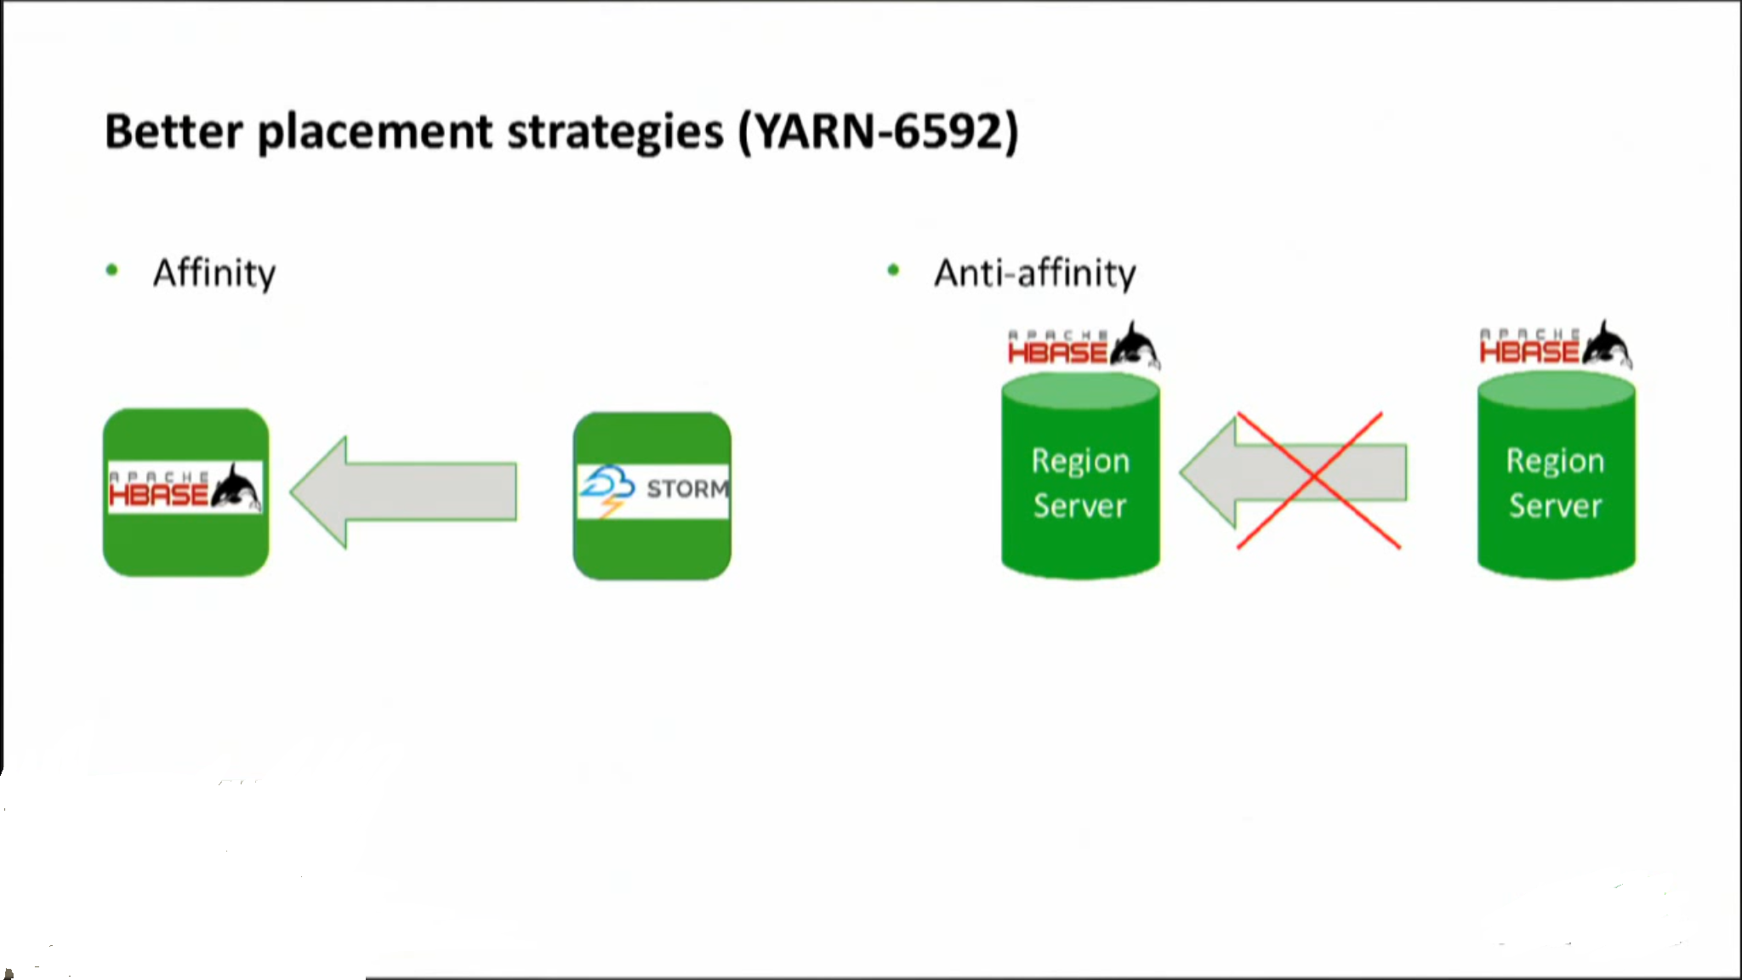
What’s new in Hadoop 3?

Slide 6
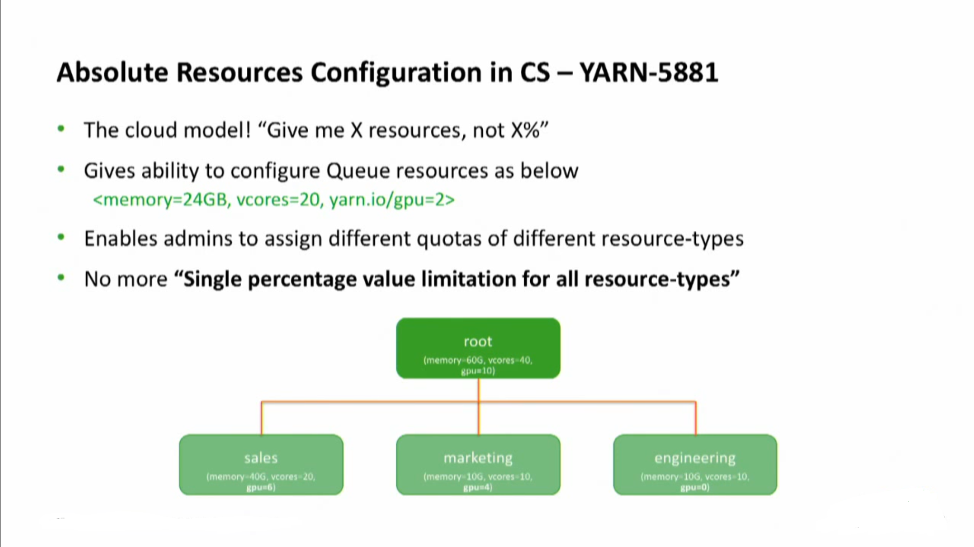
What’s new in Hadoop 3?

Slide 7
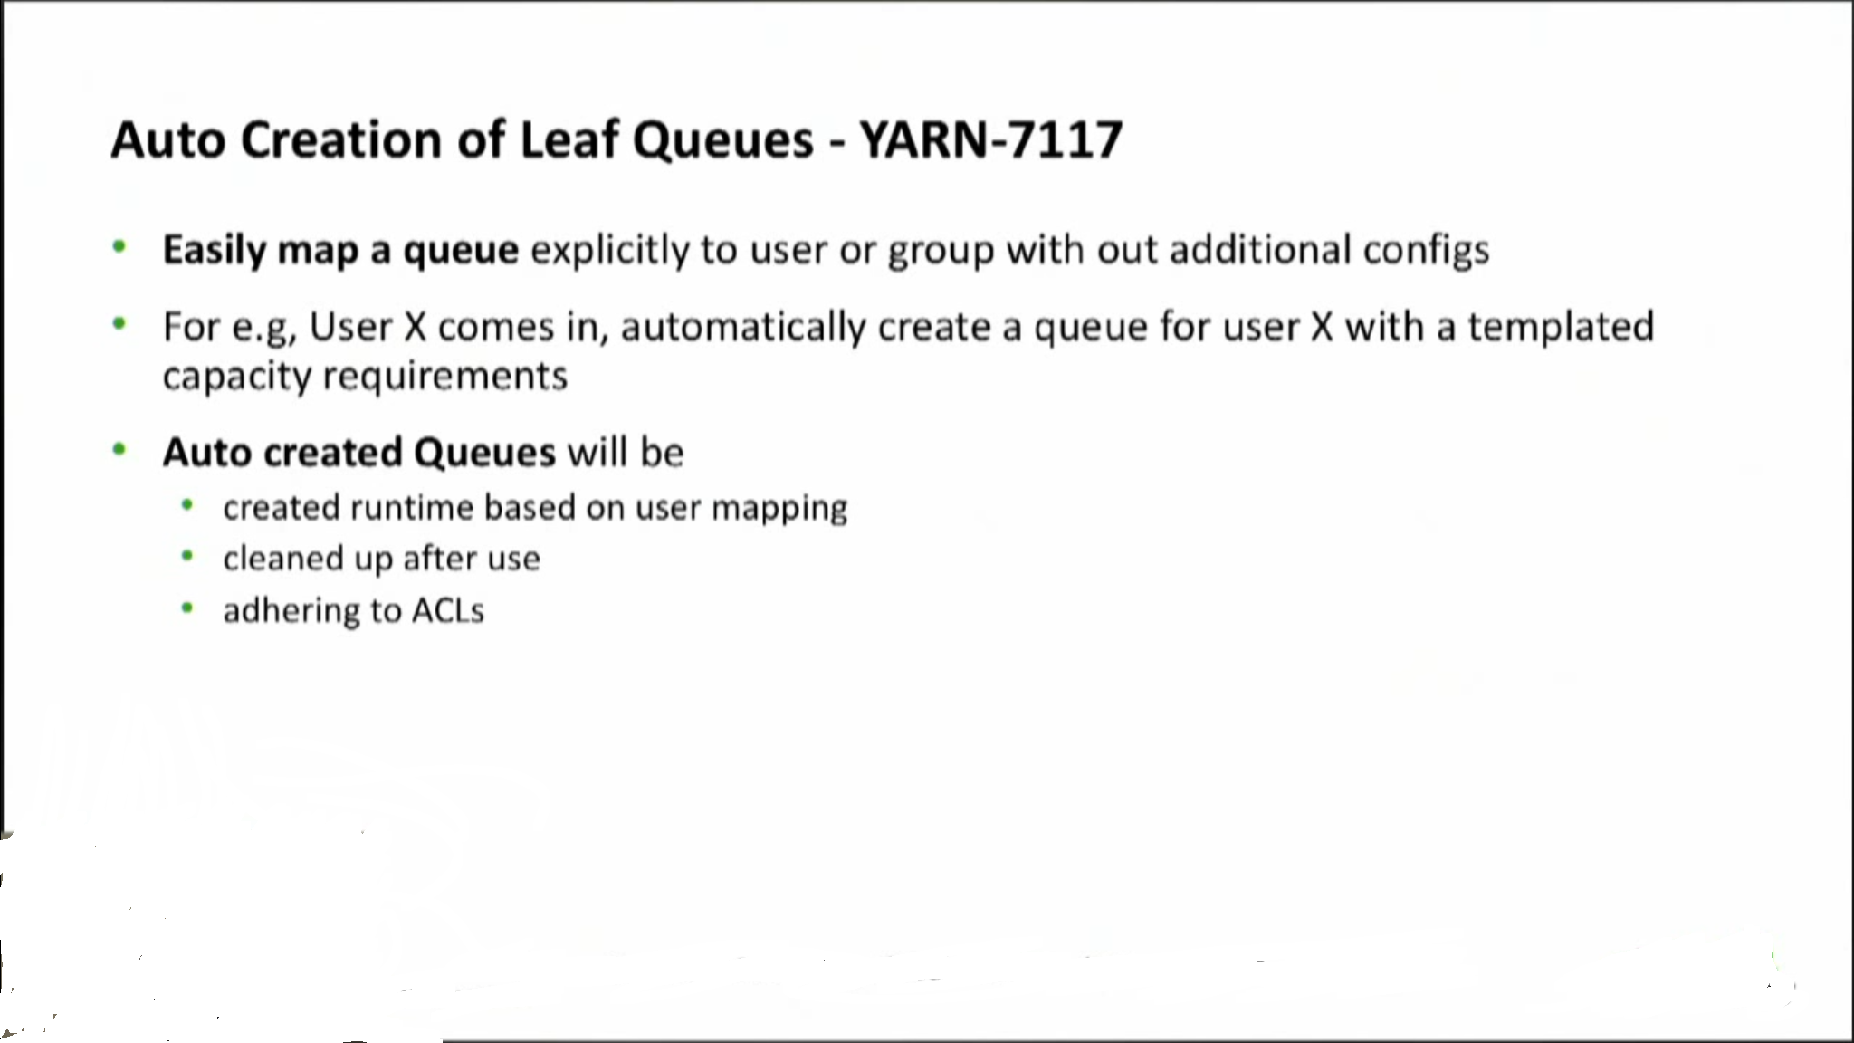
What’s new in Hadoop 3?

Slide 8
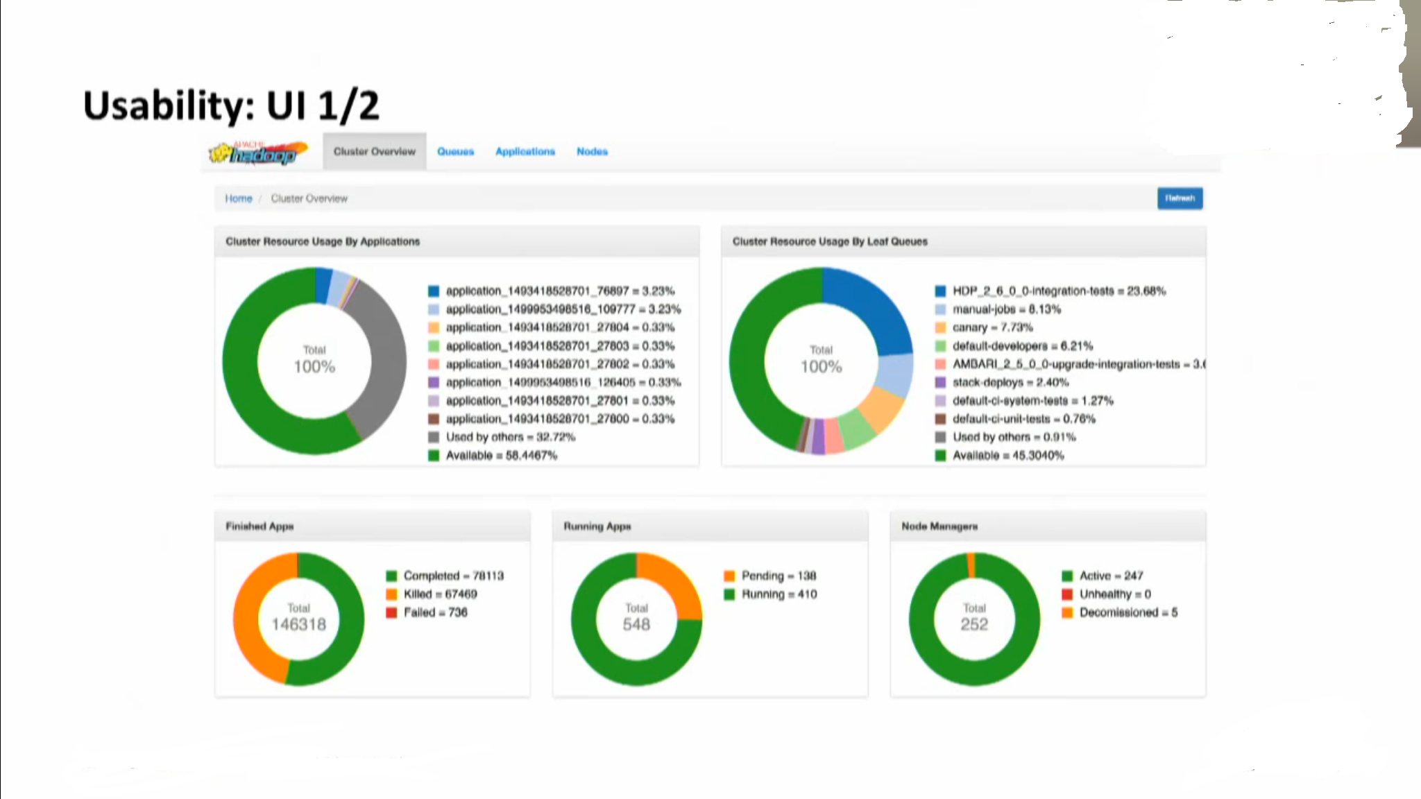
What’s new in Hadoop 3?

Slide 9
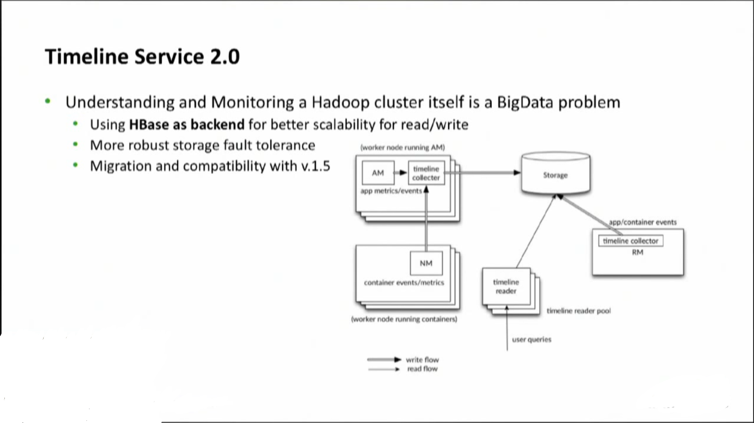
What’s new in Hadoop 3?

Slide 10
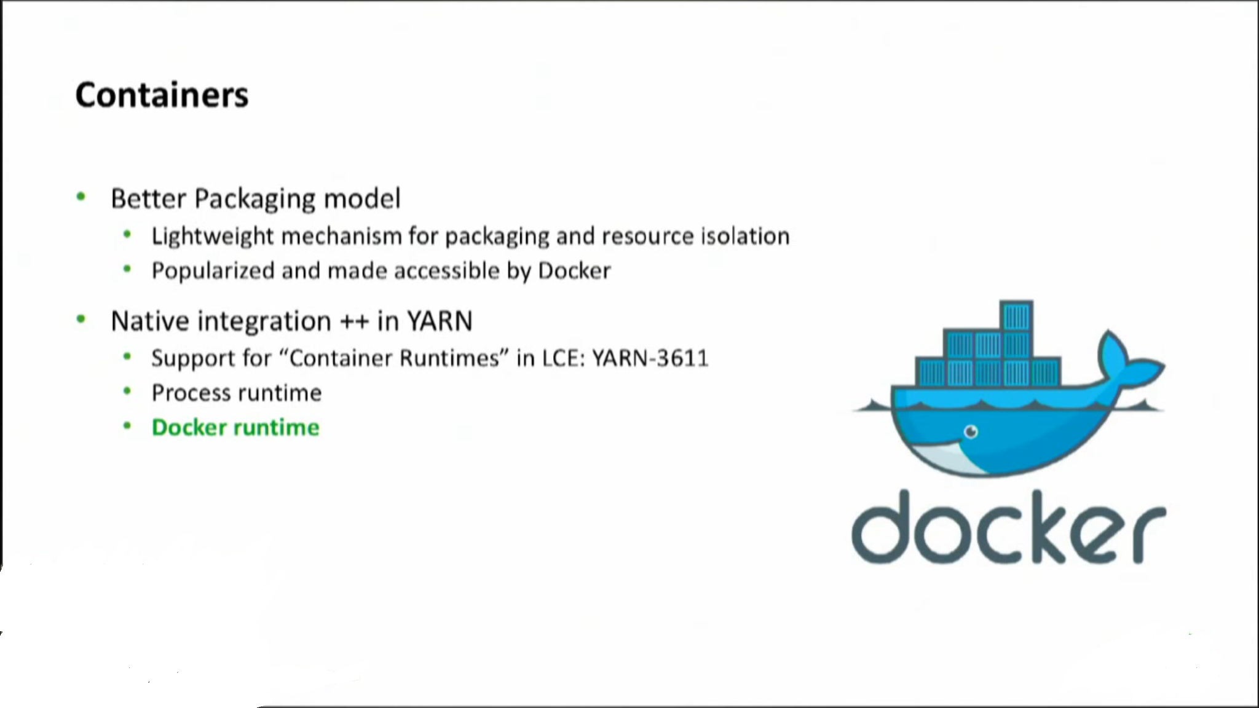
What’s new in Hadoop 3?

Slide 11
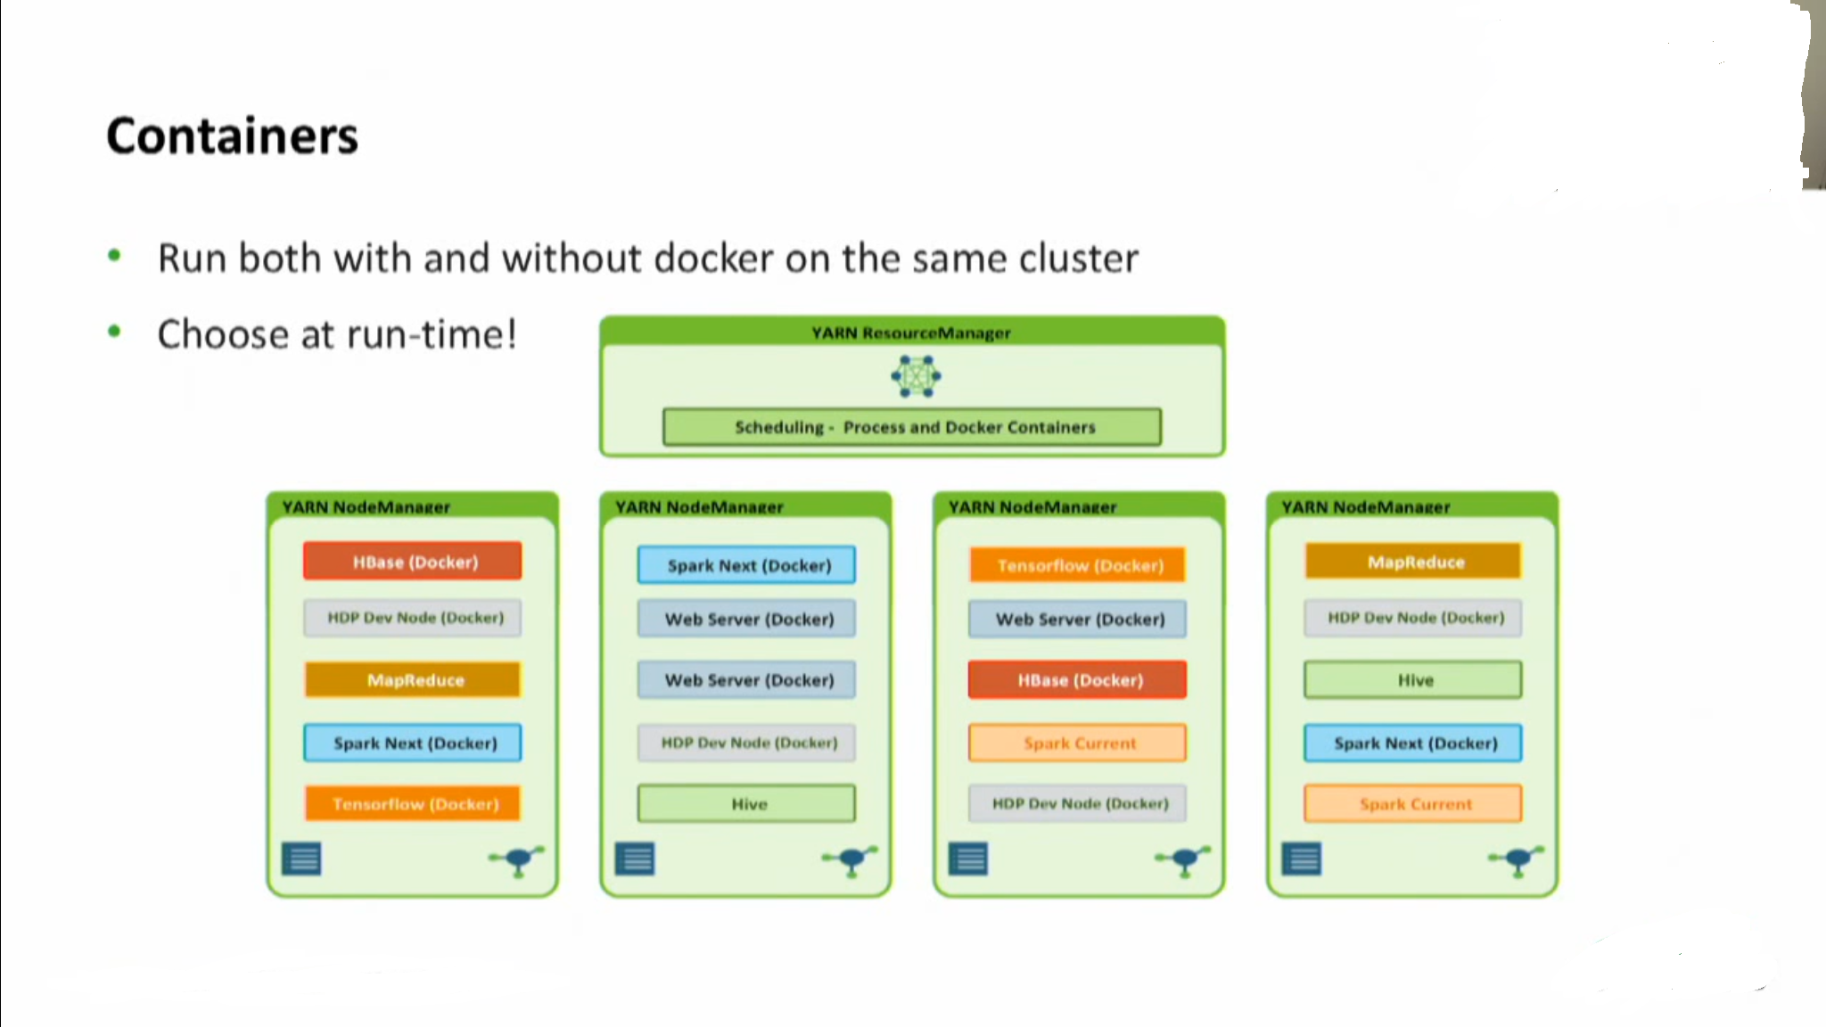
What’s new in Hadoop 3?

Slide 12
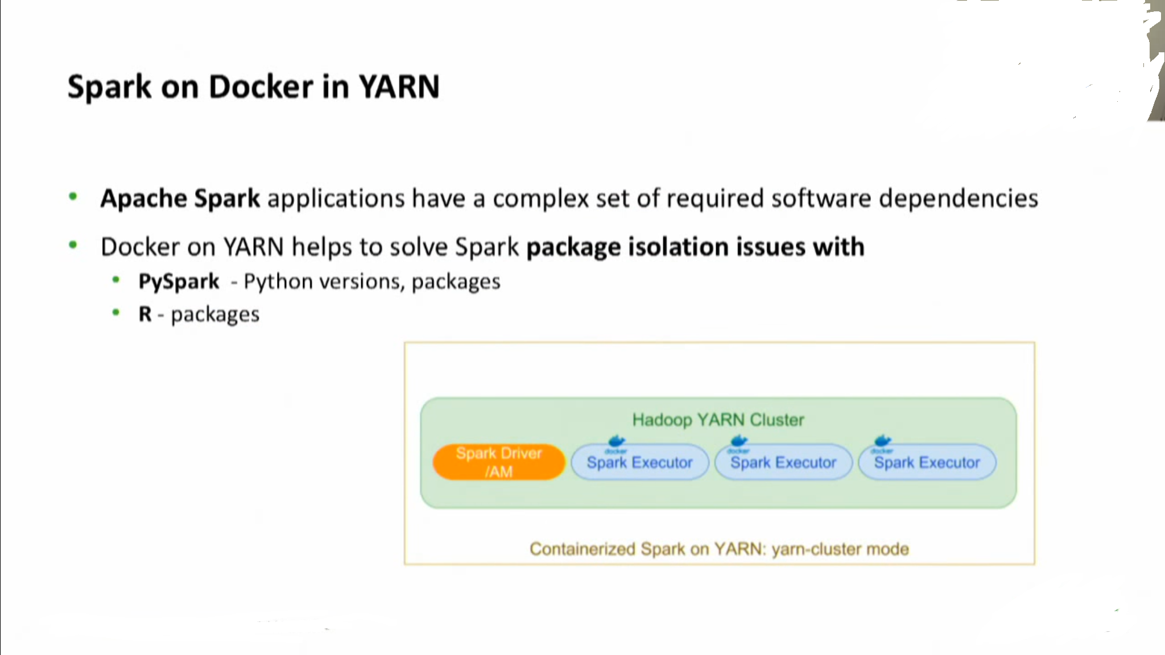
What’s new in Hadoop 3?

Slide 13
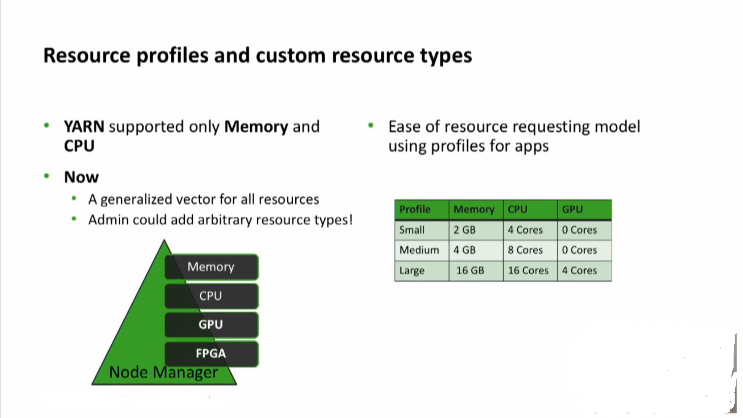
What’s new in Hadoop 3?

Slide 14
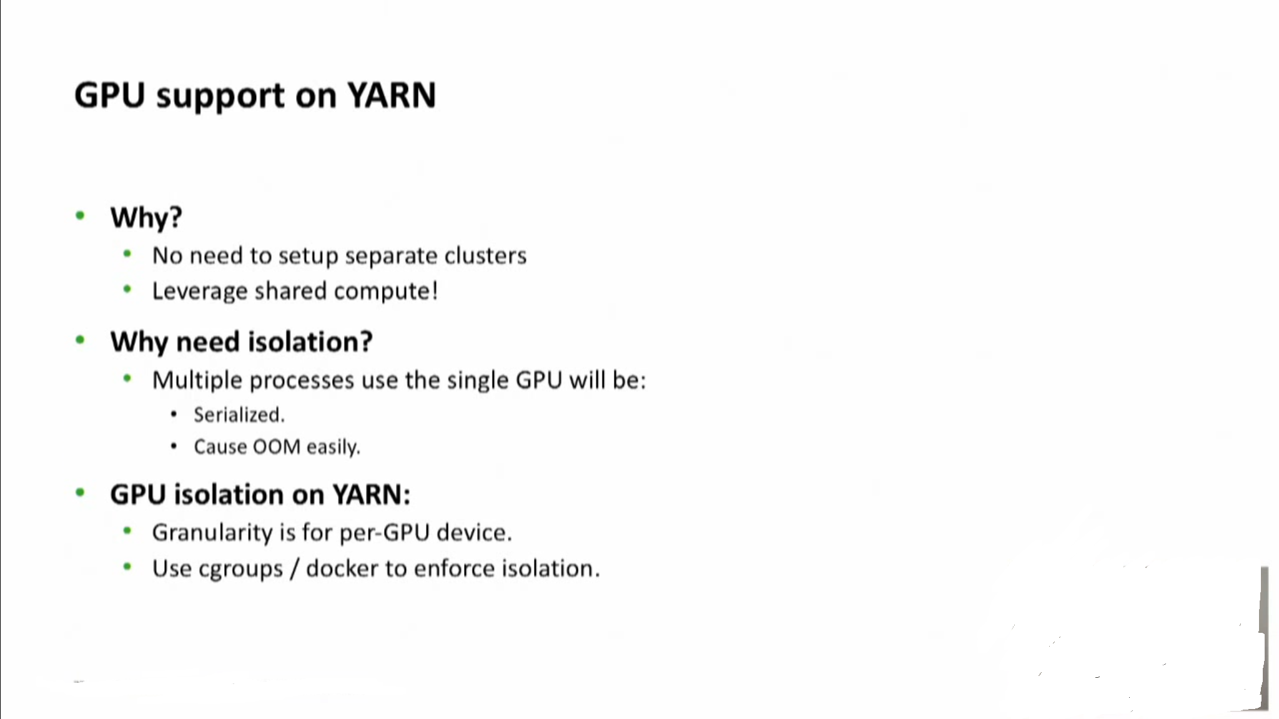
What’s new in Hadoop 3?

Slide 15
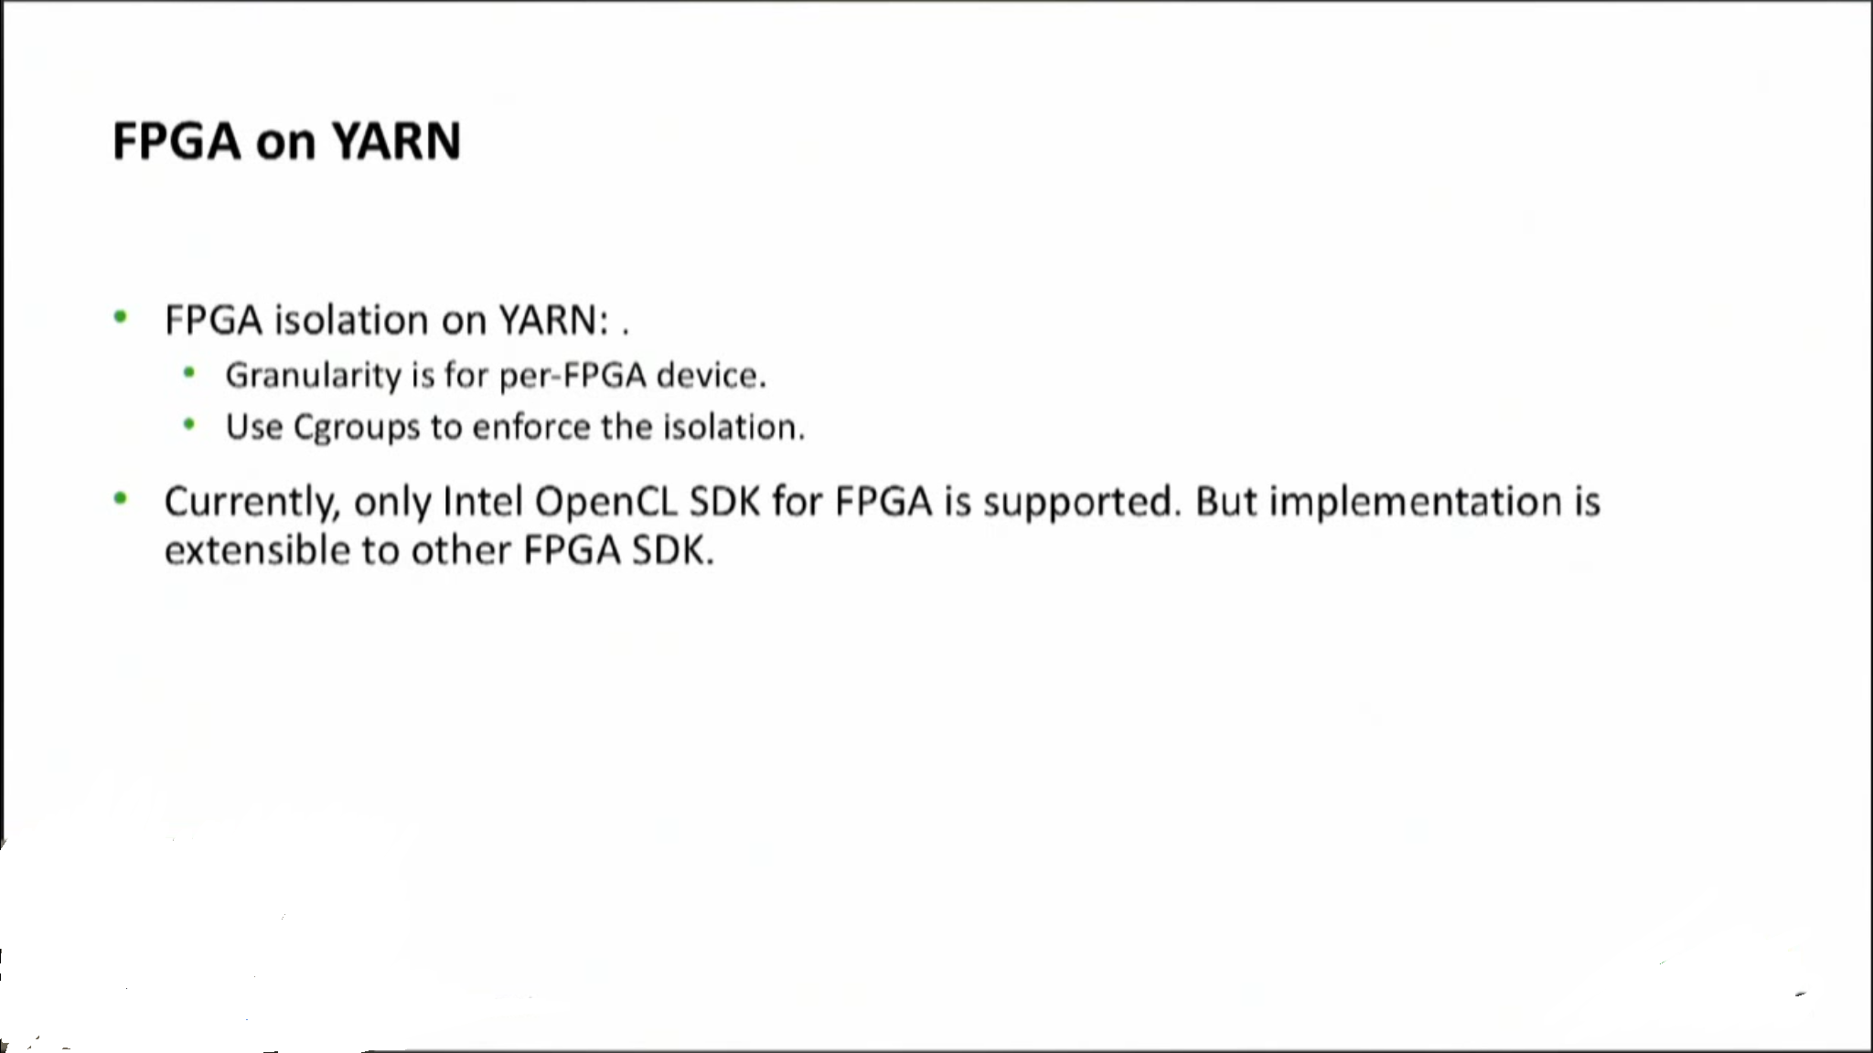
What’s new in Hadoop 3?

Slide 16
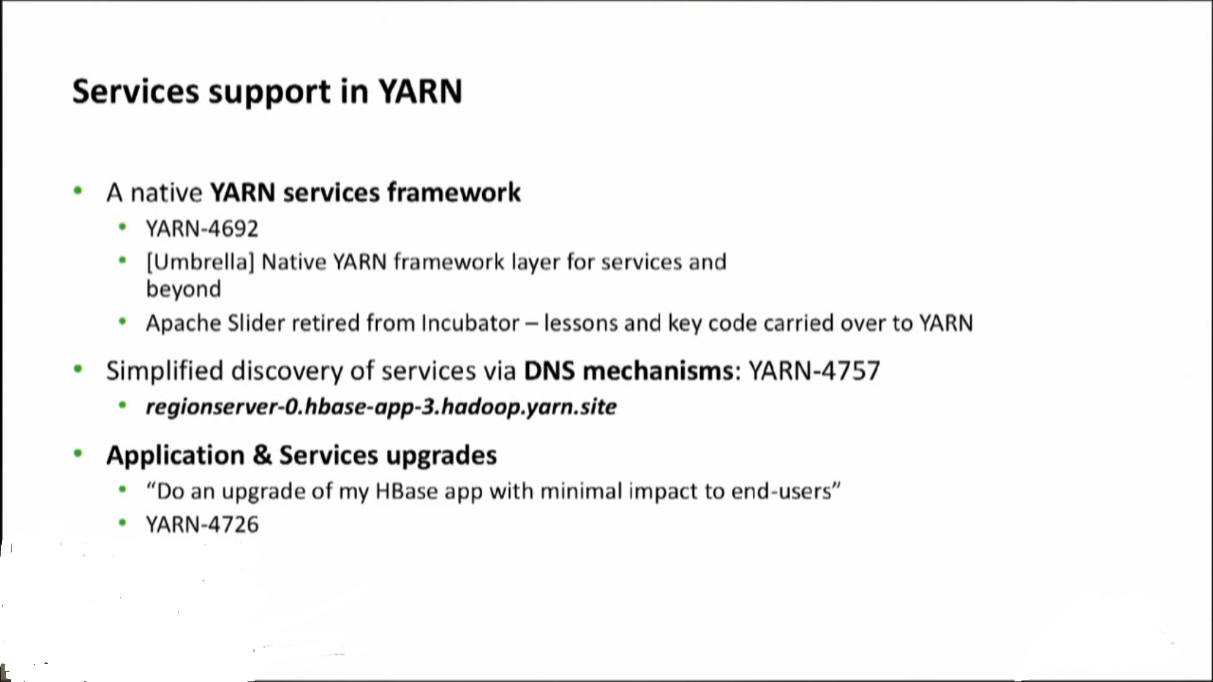
What’s new in Hadoop 3?

Slide 17
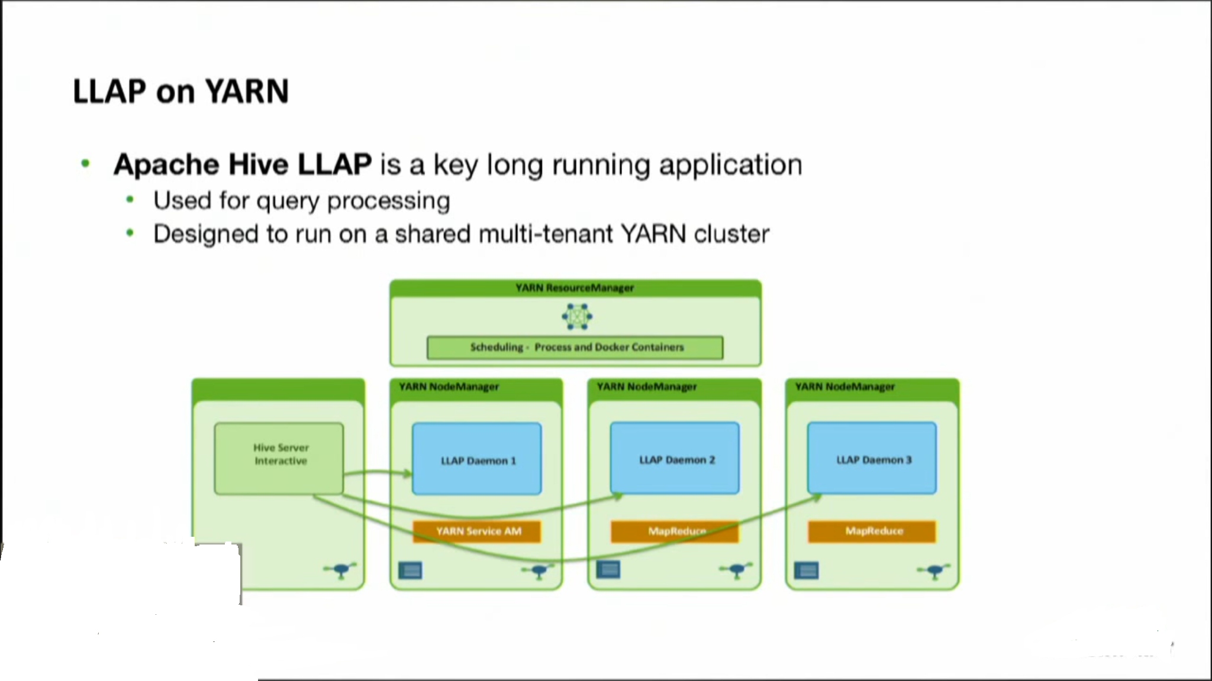
What’s new in Hadoop 3?

Slide 18
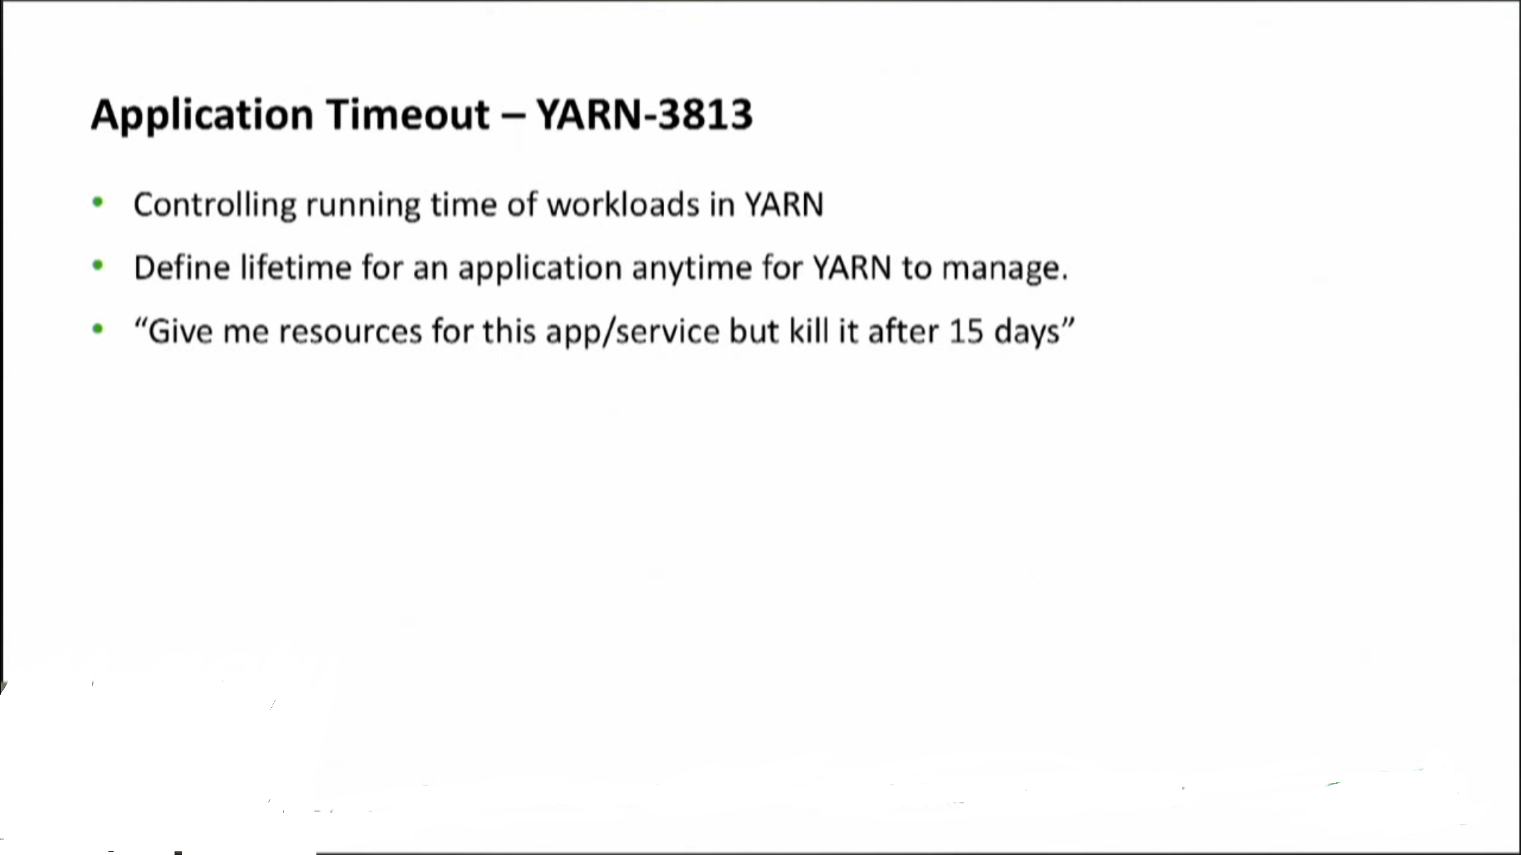
What’s new in Hadoop 3?

Slide 19
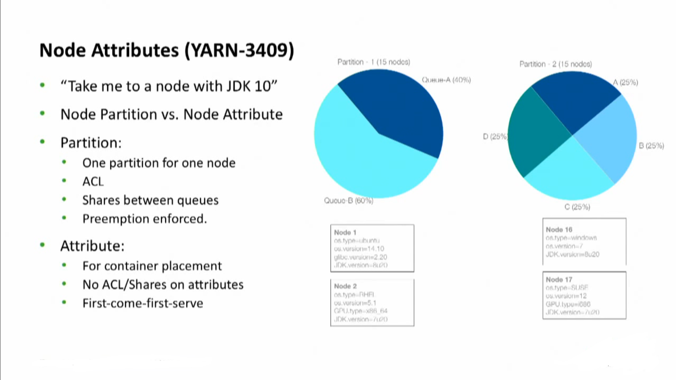
What’s new in Hadoop 3?

Slide 20
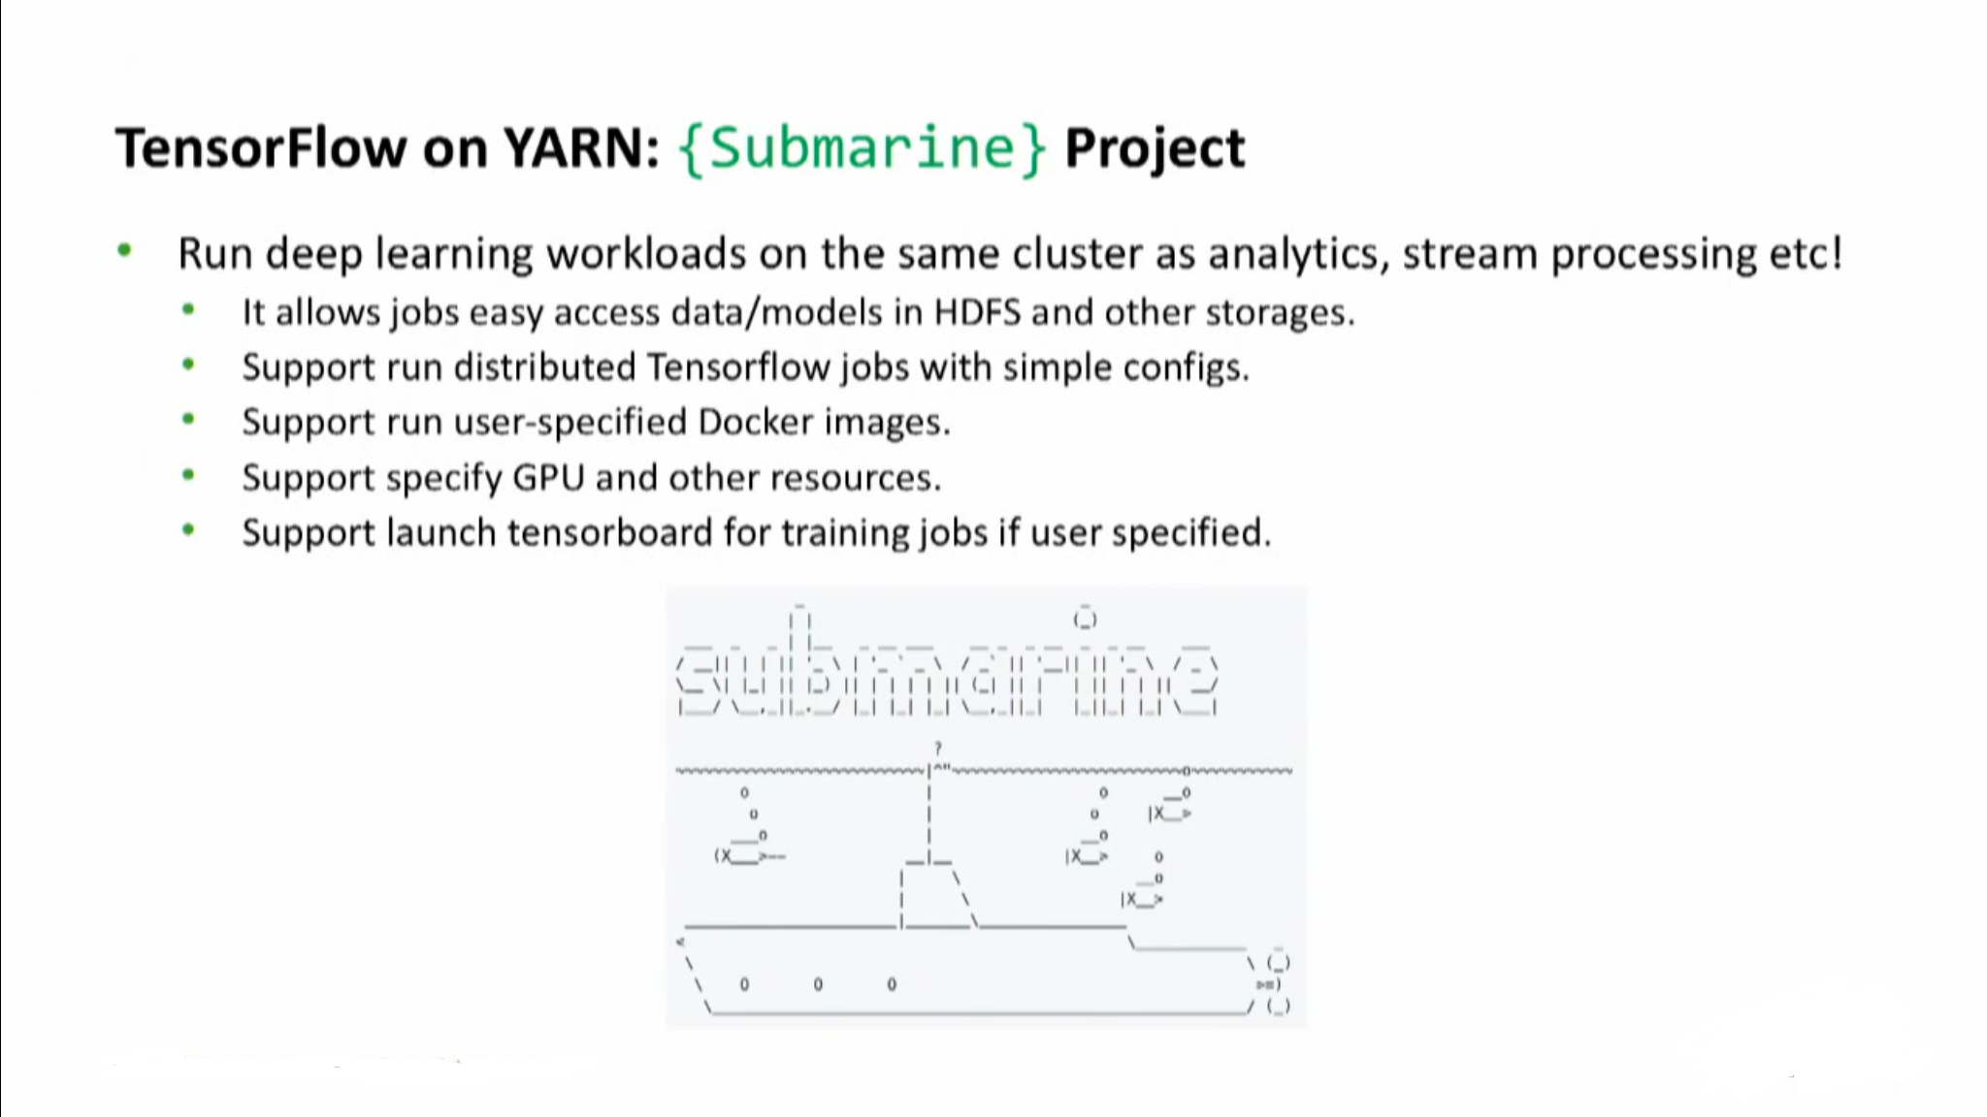
What’s new in Hadoop 3?

Slide 21
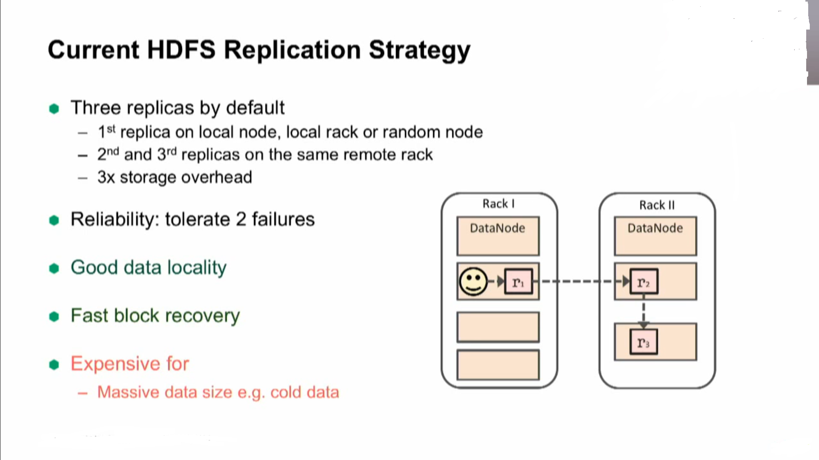
What’s new in Hadoop 3?

Slide 22
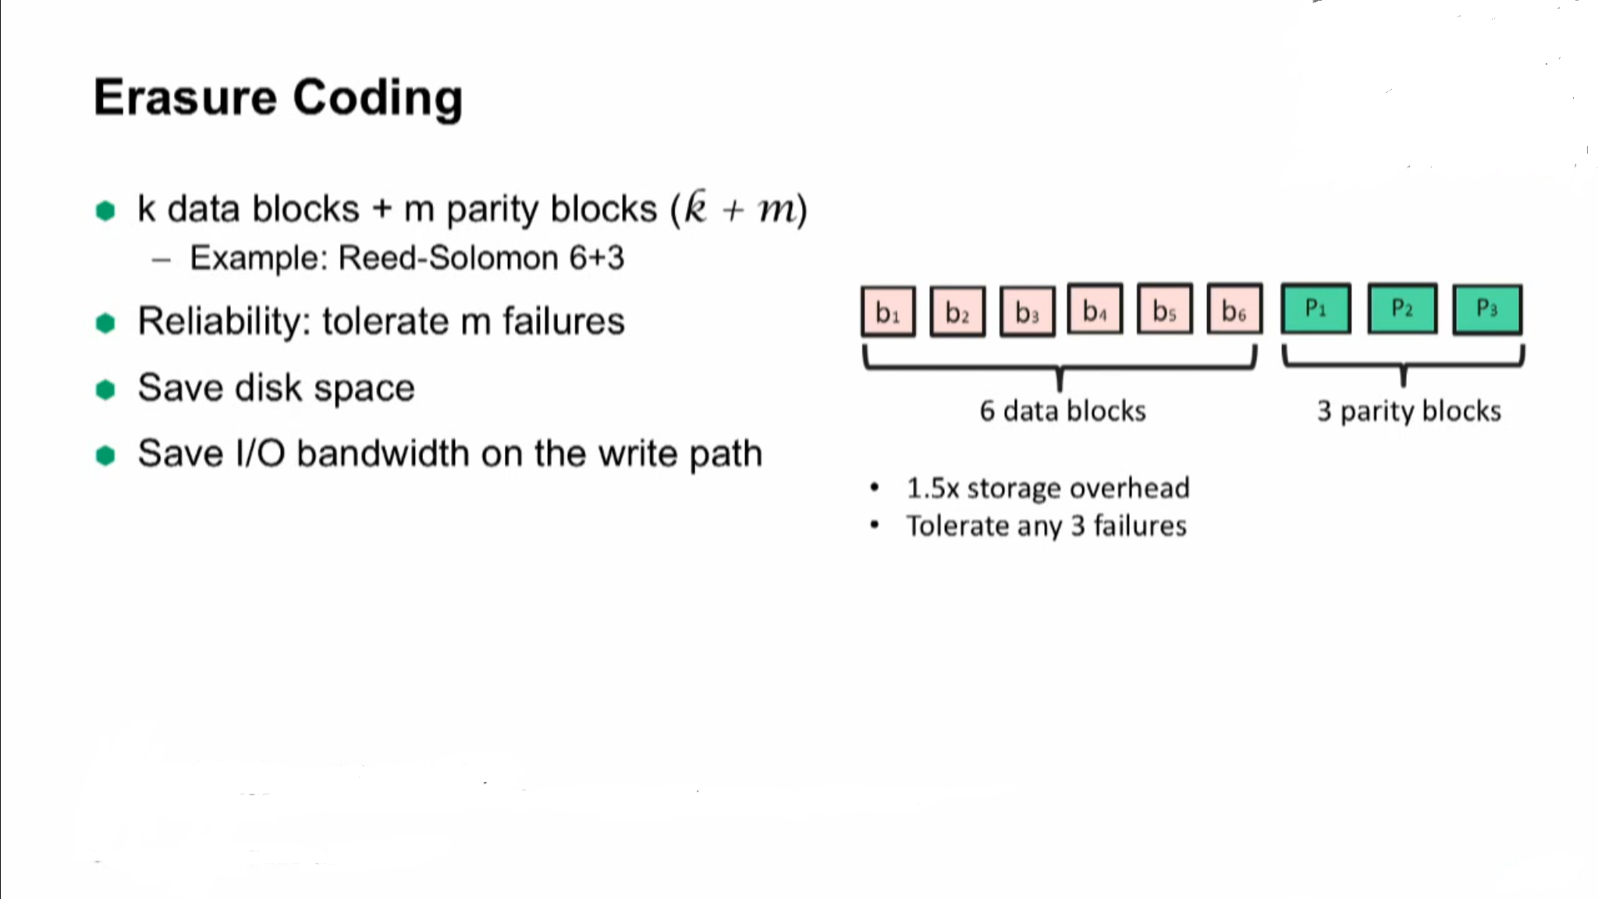
What’s new in Hadoop 3?

Slide 23
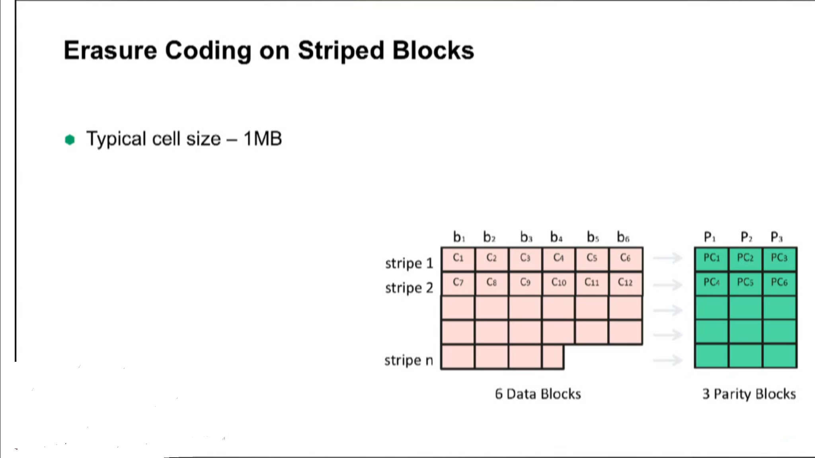
What’s new in Hadoop 3?

Slide 24
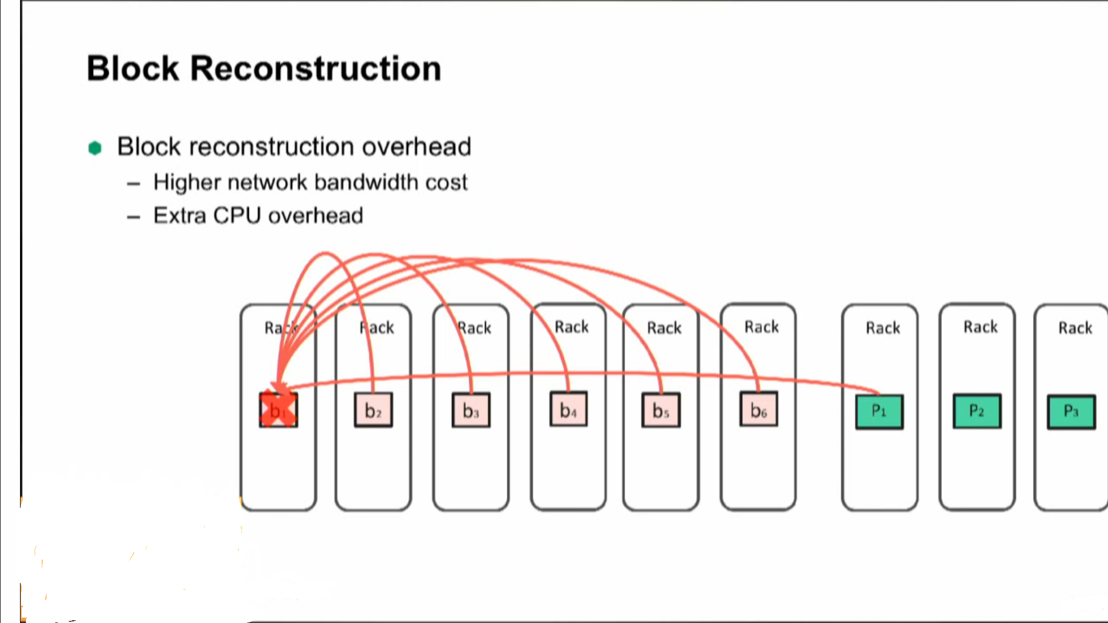
What’s new in Hadoop 3?

Slide 25
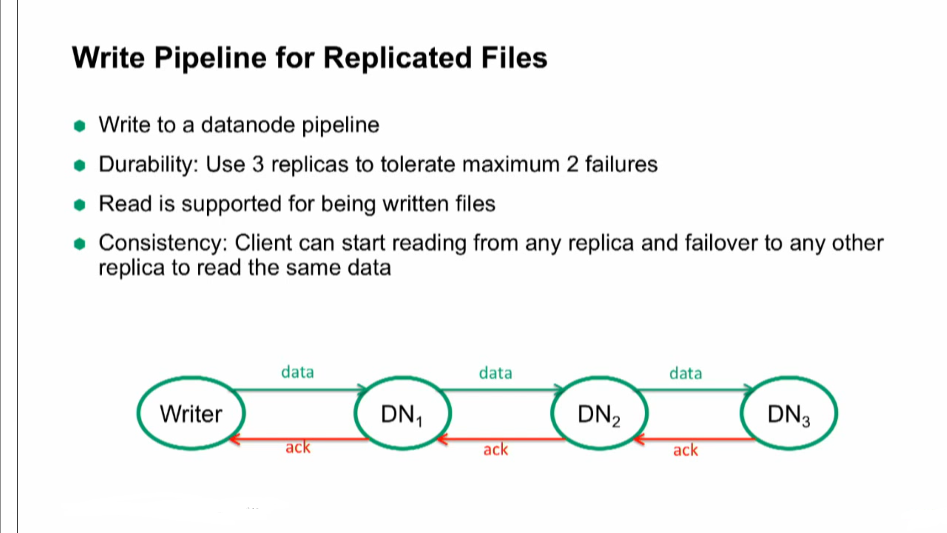
What’s new in Hadoop 3?

Slide 26
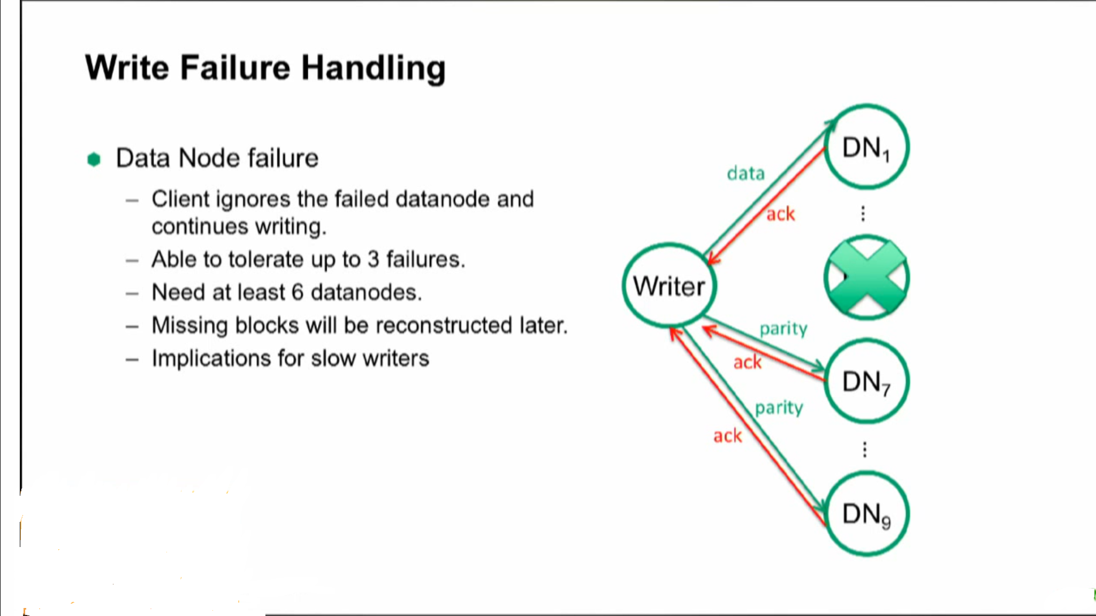
What’s new in Hadoop 3?

Slide 27
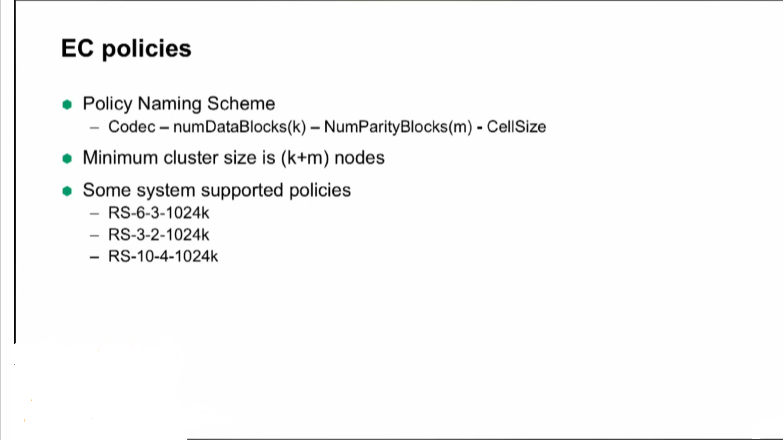
What’s new in Hadoop 3?

Slide 28
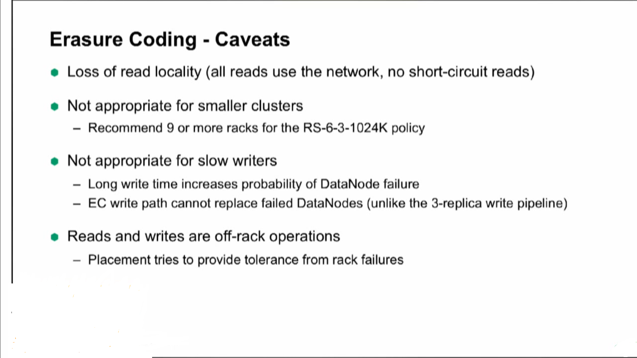
What’s new in Hadoop 3?

Slide 29
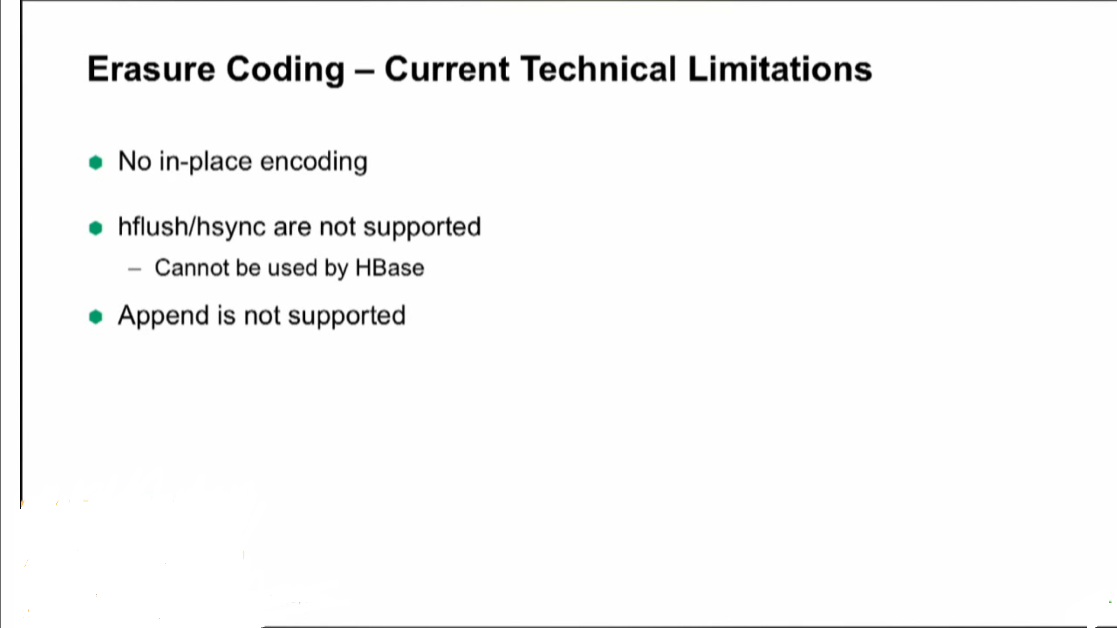
What’s new in Hadoop 3?

Slide 30
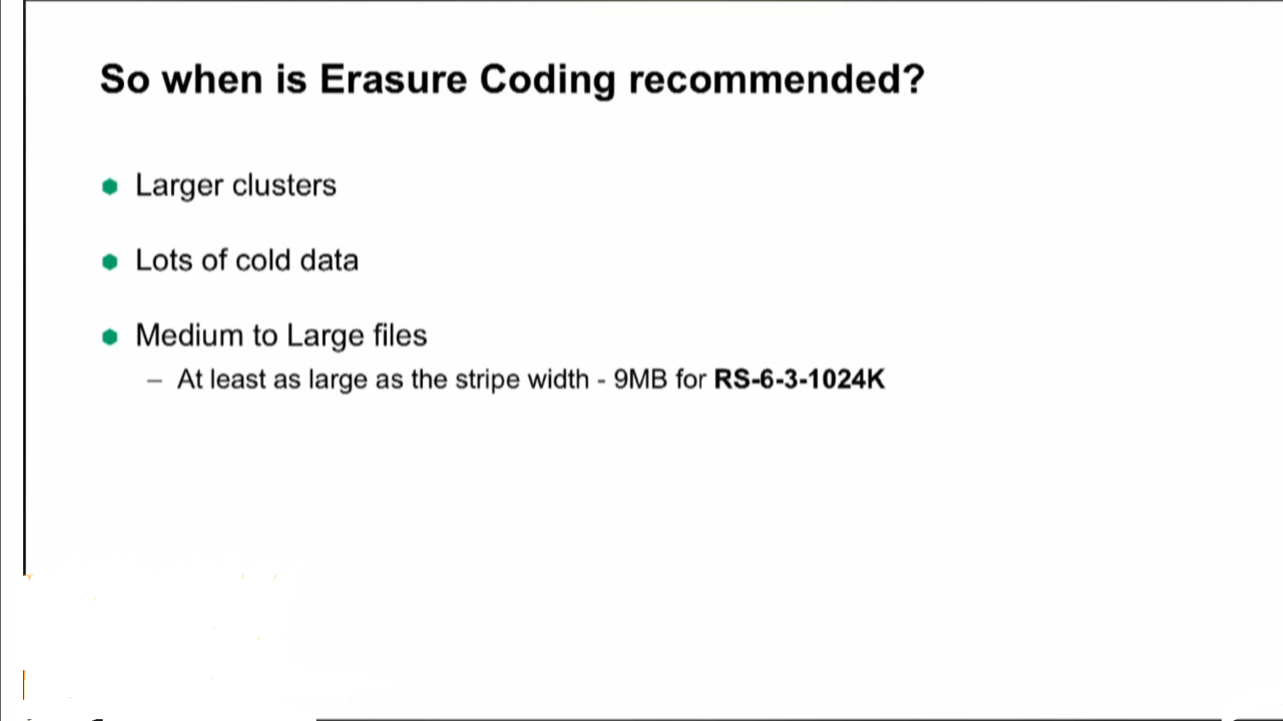
What’s new in Hadoop 3?

Slide 31
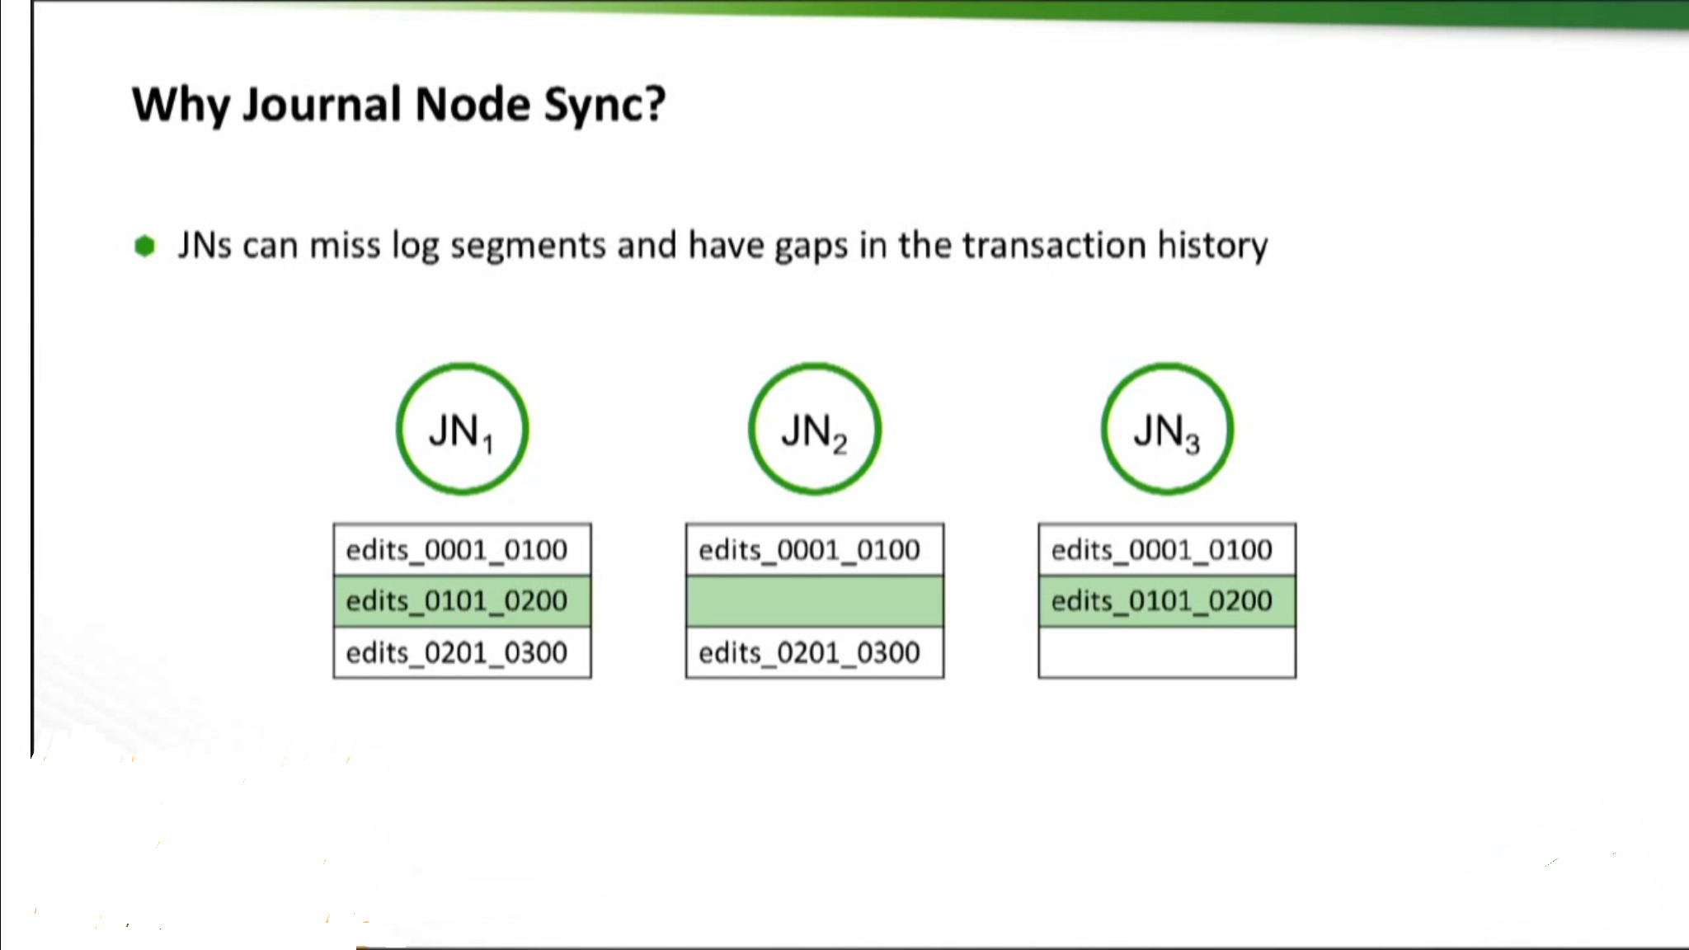
What’s new in Hadoop 3?

Slide 32
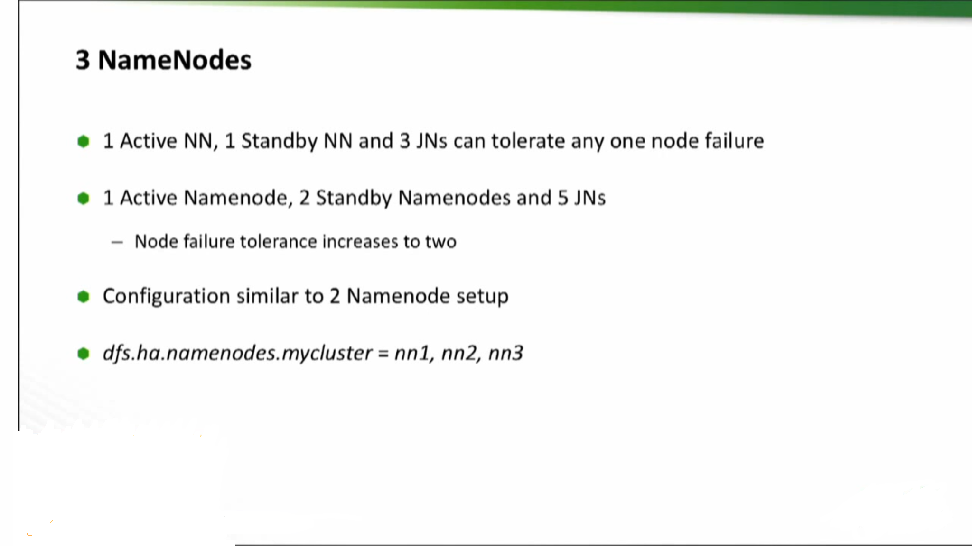
What’s new in Hadoop 3?

